Slide 1
One Football by Joshua

Slide 2
Agenda
Introduction
Index page
Engaging the audience
Visual aids
Final tips & takeaways

Slide 3

Introduction
The existing website is built using HTML, CSS, and JavaScript.
This foundation provides a solid base for future development.
While the report doesn't have access to the specific implementation details,
it assumes a standard structure where HTML provides the content and structure, CSS handles the styling, and JavaScript adds interactivity.

Slide 4
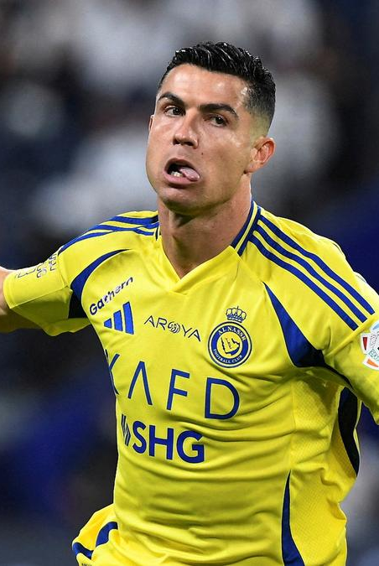
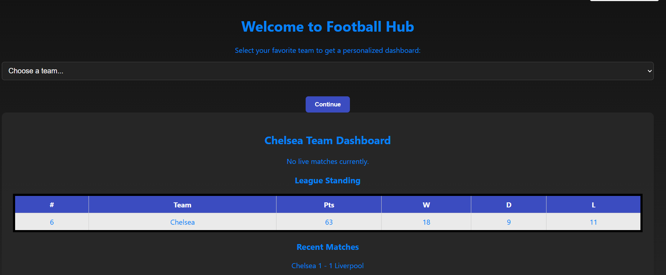
Index page​
The primary entry point for users, to enter their favourite teams

Slide 5
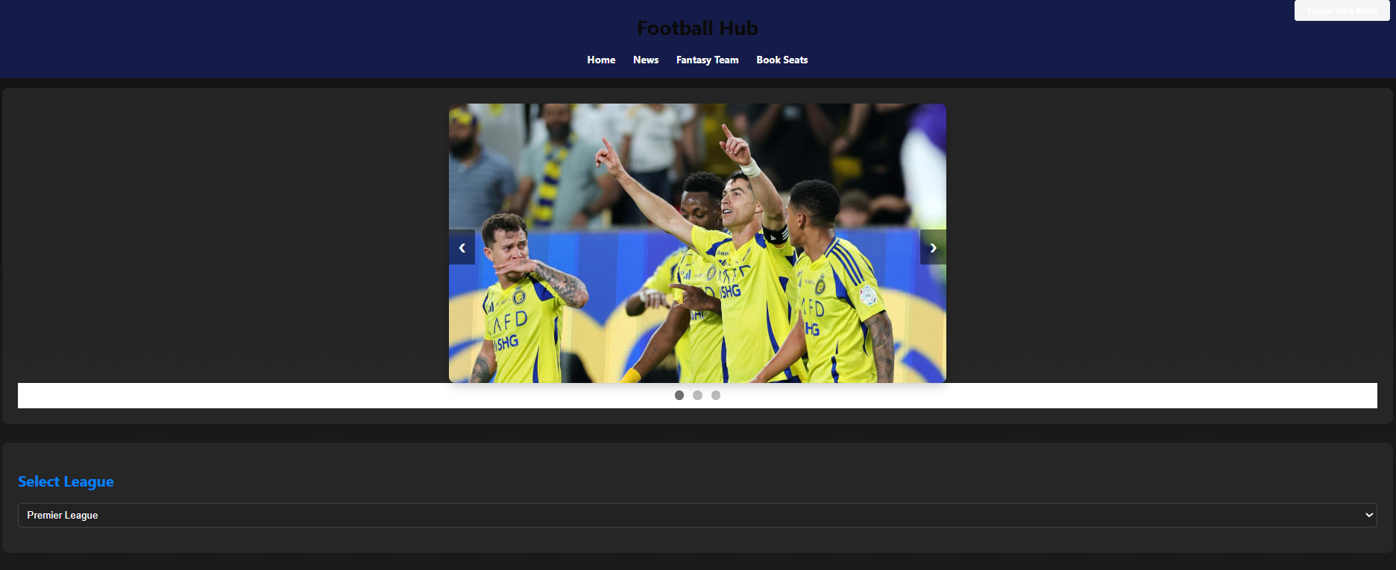
Home page​
The primary entry point for users, designed to showcase key features and attract engagement. Have to implement APIs for Live scores and Upcoming Fixtures

Slide 6
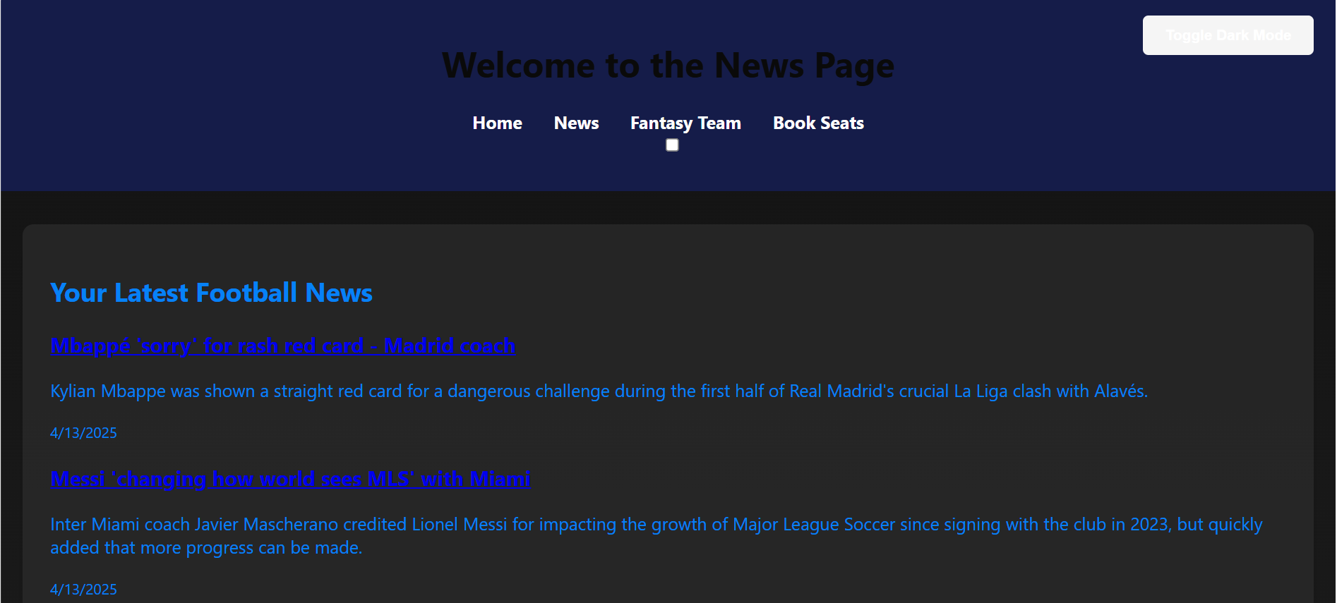
news page​
Integrating a news API will automate fetching and displaying football news. This will ensure that the news page is always up to date with minimal manual intervention. Consider APIs like ESPN API, News API, or others specializing in sports news.

Slide 7
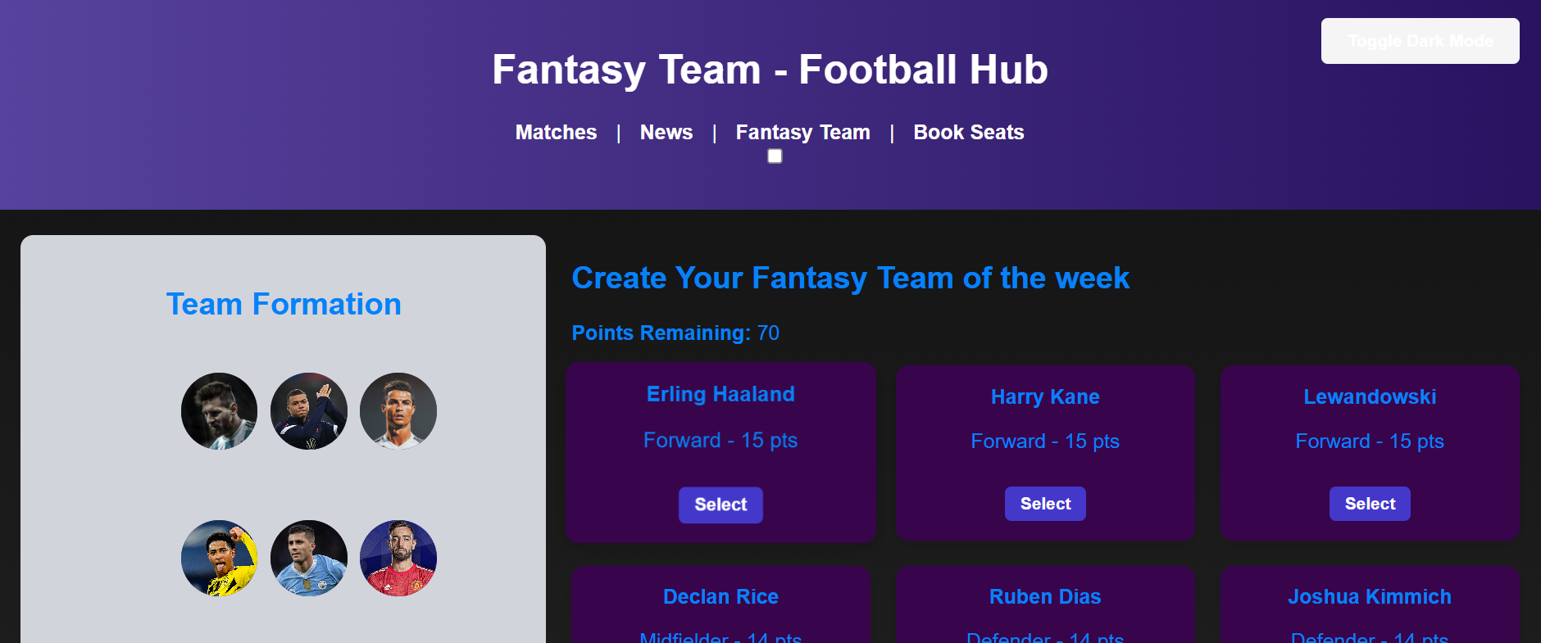
Fantasy page​
A hub for information and links related to fantasy football platforms like bet365. Making your own fantasy team

Slide 8
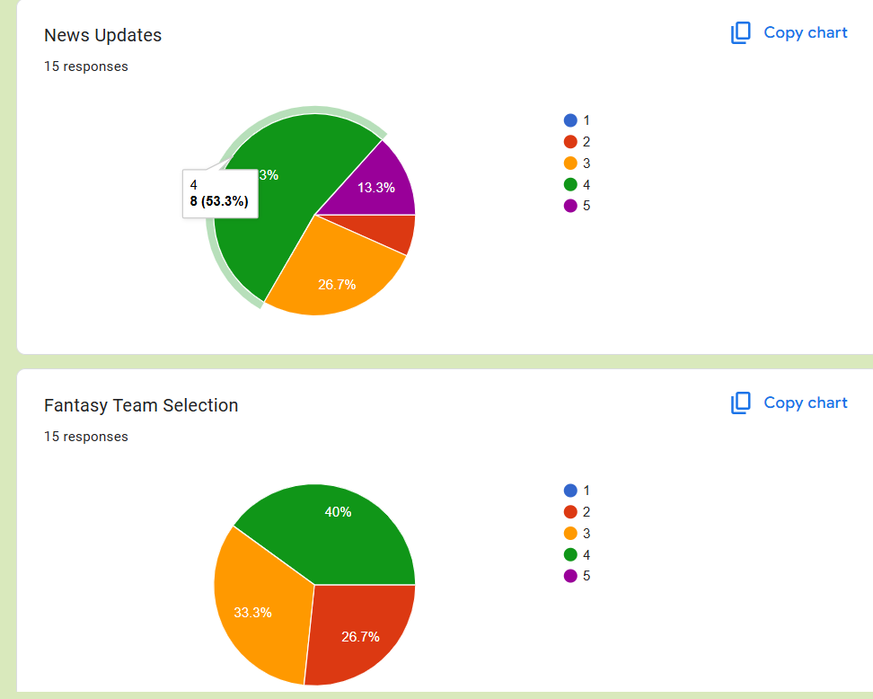
Engaging the audience
We used live polls or surveys to gather audience opinions, promoting engagement and making sure the audience feel involved
Personalized content for every user based on selected teams
User friendly menu navigations
Easy seat bookings
Building a lovely football community

Slide 9
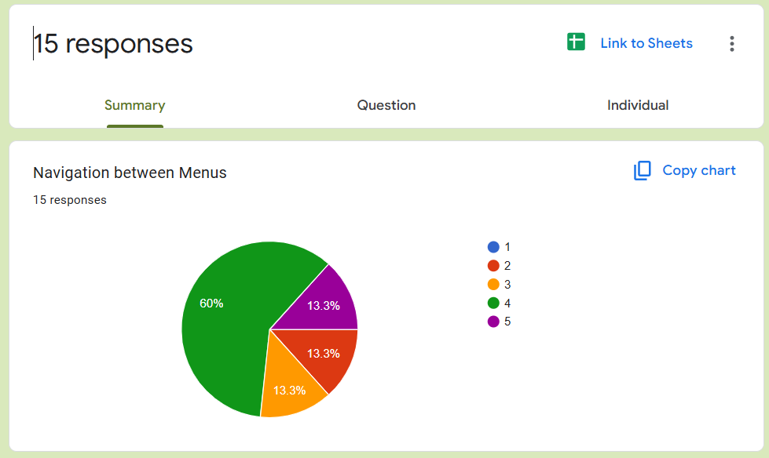
Engaging the audience
We used live polls or surveys to gather audience opinions, promoting engagement and making sure the audience feel involved
Personalized content for every user based on selected teams
User friendly menu navigations
Easy seat bookings
Building a lovely football community

Slide 10
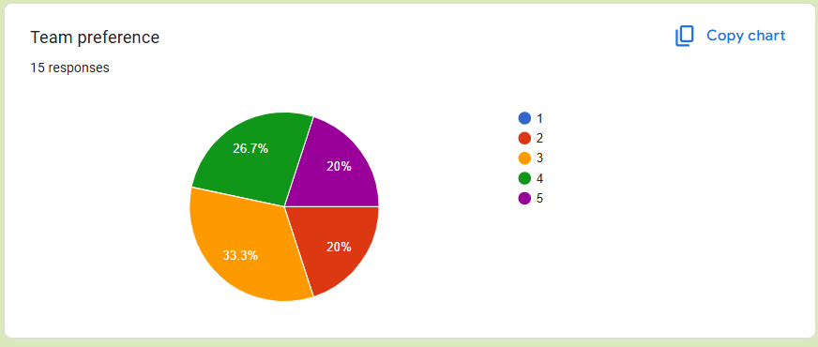
Engaging the audience
We used live polls or surveys to gather audience opinions, promoting engagement and making sure the audience feel involved
Personalized content for every user based on selected teams
User friendly menu navigations
Easy seat bookings
Building a lovely football community

Slide 11
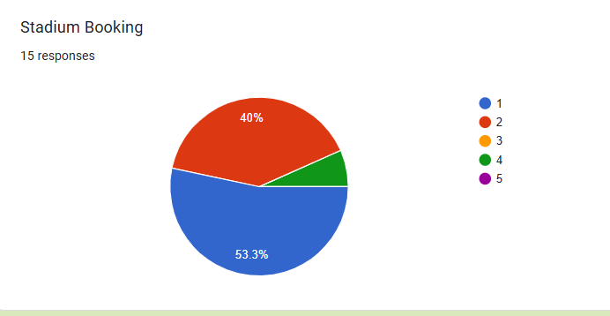
Engaging the audience taking the negative Feedbacks and improving in the next update
We used live polls or surveys to gather audience opinions, promoting engagement and making sure the audience feel involved
Personalized content for every user based on selected teams
User friendly menu navigations
Easy seat bookings
Building a lovely football community

Slide 12
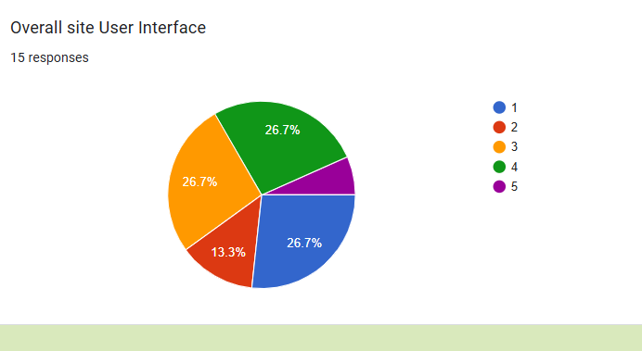
Engaging the audience Around 45-50% of people voted have given us a 3-5 star rating. And are looking to improve that number in the future
We used live polls or surveys to gather audience opinions, promoting engagement and making sure the audience feel involved
Personalized content for every user based on selected teams
User friendly menu navigations
Easy seat bookings
Building a lovely football community

Slide 13
THANK YOU
Joshua Santhumayor
502-555-0152​
joshua@onefootball.com​
onefootball.com

